Slide 1
ElectViz
By Diksha Palliwal,
Under the Guidance of Mentor NITHYASRI. S. J.
Election Data Visualization for Media

Slide 2
Acknowledgment
We would like to express our heartfelt gratitude to: Infosys Springboard Team – for organizing this valuable internship opportunity. Our Mentor – for her continuous support and feedback. My Teammates – for collaboration, encouragement, and insights This internship has been a significant step in our professional growth and technical journey.

Slide 3
Introduction
ElectViz is an interactive Power BI dashboard designed to analyze Indian election data across multiple years.
It provides insights into party performance, voter turnout, candidate demographics, gender distribution, and election trends at national and state levels.
Using dynamic filters and visualizations, this dashboard helps in understanding voting patterns, electoral strength of parties, and key factors influencing election outcomes in a simple and data-driven way.

Slide 4
System Design – High Level Architecture
Data Sources
Election datasets (CSV / Excel / Database)
Data Processing (Data Science Layer)
Data cleaning, transformation, and feature engineering
(vote share, turnout %, margins, age groups)
Data Modeling
Fact–Dimension (Star Schema) model
Enables fast aggregation and filtering
Visualization Tool
Power BI for interactive dashboards and analytics

Slide 5
Analytics & Visualization Layer
Business Logic (DAX Measures)
Total votes
Seats won
Vote share %
Winning margin
Close contest rate
Visual Components
KPI cards for key metrics
Bar & line charts for trends
Donut charts for distribution
Maps for state-wise analysis
Interactivity
Year, party, and state slicers
Cross-filtering between visuals

Slide 6
Workflow
Raw Election Data
↓
Data Cleaning & Feature Engineering
↓
Data Modelling & DAX Calculations
↓
Interactive Power BI Visualizations
↓
Insights & Decision Support

Slide 7
Future Enhancements – ElectViz Dashboard
Real-time Data Integration
Connect live election APIs for real-time result updates
Predictive Analytics
Use machine learning models to forecast election outcomes and voter turnout
Sentiment Analysis
Integrate social media and news sentiment to analyze public opinion trends
Advanced Drill-Downs
Enable constituency-level and booth-level analysis for deeper insights
Geospatial Enhancements
Add heatmaps and spatial clustering for regional voting patterns

Slide 8
Workflow
Raw Election Data
↓
Data Cleaning & Feature Engineering
↓
Data Modelling & DAX Calculations
↓
Interactive Power BI Visualizations
↓
Insights & Decision Support

Slide 9
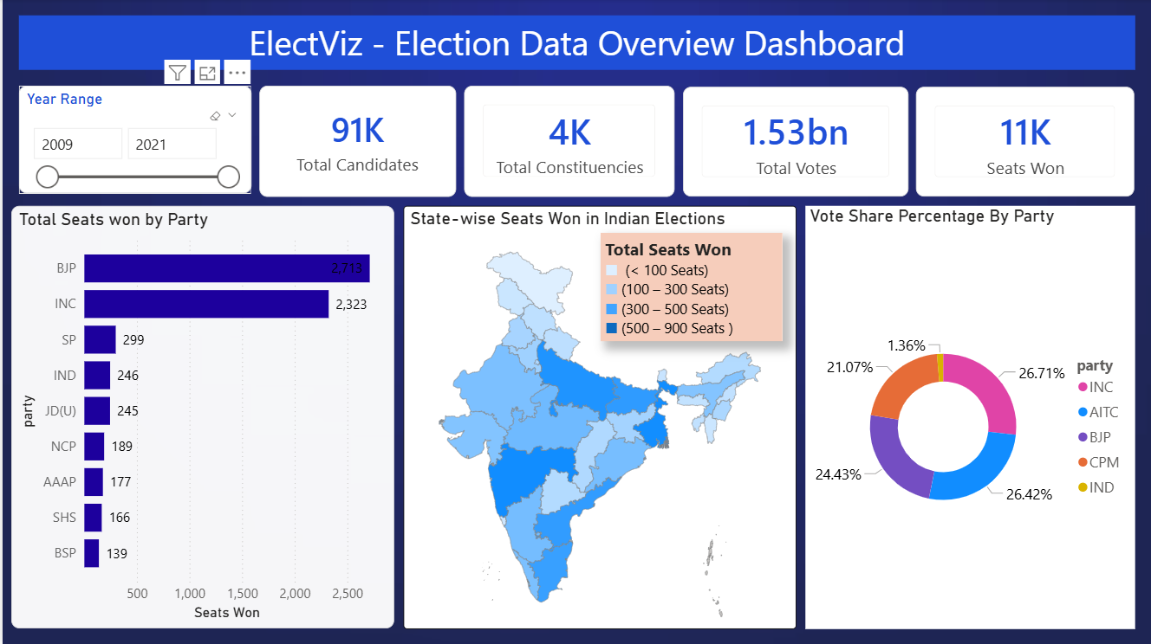
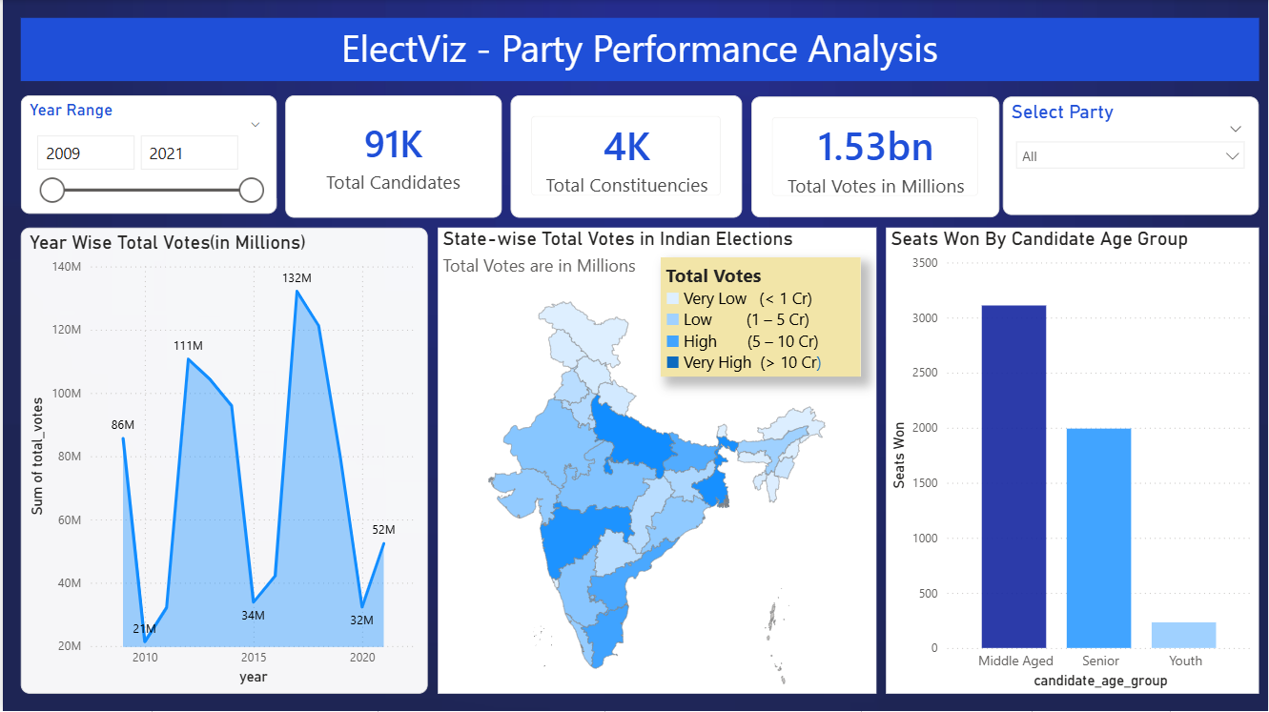
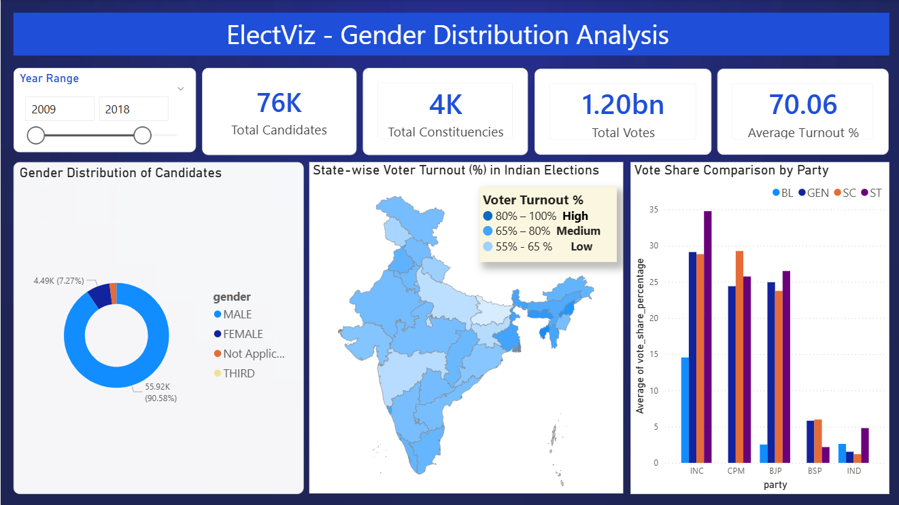
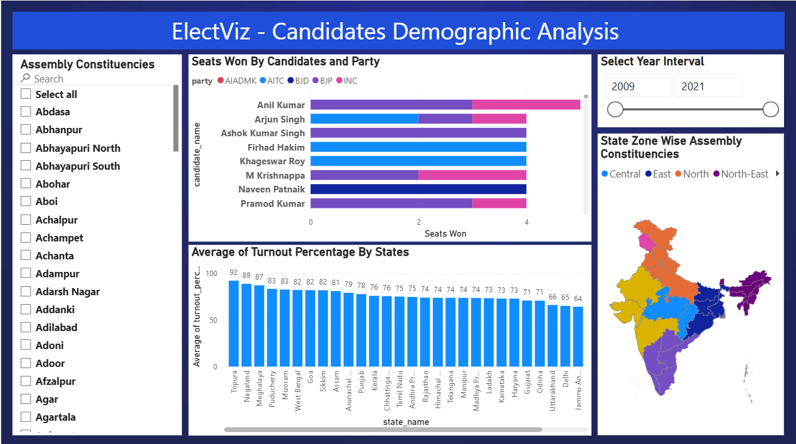
Actual Dashboard

Slide 10
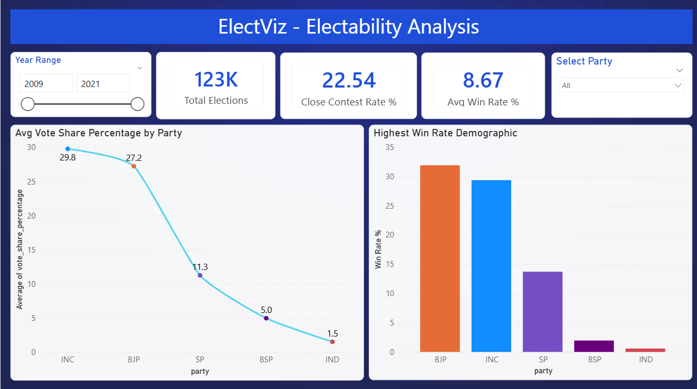
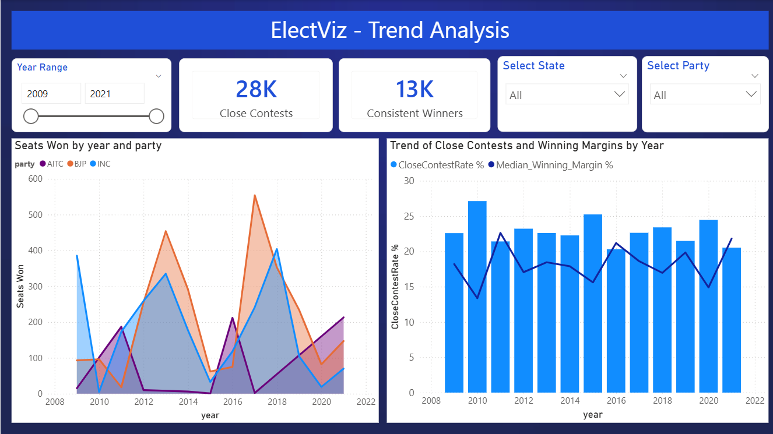
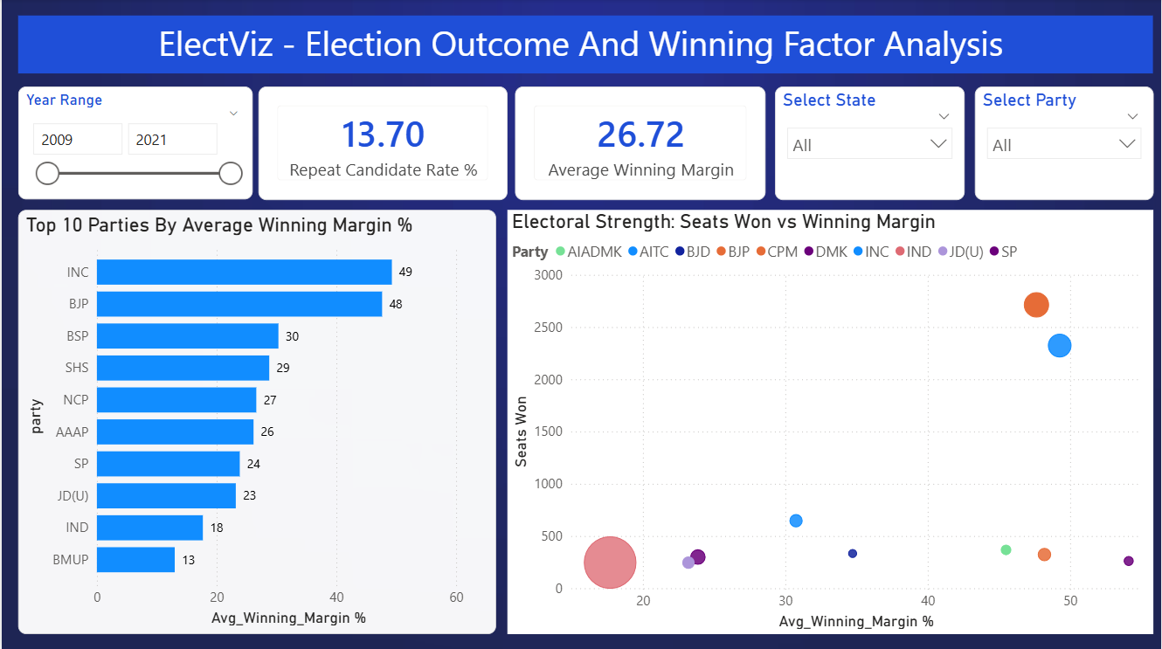
Actual Dashboard

Slide 11
Key Insights Gained – ElectViz Dashboard
Identified major political parties’ performance trends across multiple election years
Observed significant variations in voter turnout across states and regions
Analyzed vote share distribution to understand party dominance and competition
Found demographic patterns such as age and gender influencing election outcomes
Detected closely contested constituencies using winning margin analysis
Highlighted regional strongholds and weak zones for major parties
Revealed long-term electoral trends through year-wise comparative analysis

Slide 12
Conclusion
ElectViz successfully transforms raw election data into meaningful insights using data science and visualization techniques.
The dashboard enables clear analysis of party performance, voter behavior, and electoral trends across regions and years.
Interactive Power BI visuals make complex data easy to explore and understand.
This project demonstrates the effective use of data preprocessing, analytical modeling, and visual storytelling for decision support.
ElectViz can be further enhanced with predictive analytics and real-time data to support advanced electoral analysis.

Slide 13
Thank You

